Slide 1

How to have Better Customer Care Conversations using Your Data and Watsonx.ai
Nirandika Wanigasekara, PhD
AI Engineer
watsonx.ai
Notes:
Curated by Catherine.Cao@ibm.com

Slide 2




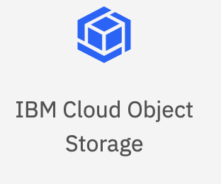

Retrieval-Augmented Generation (RAG)
Chatbot
1. Search
2. Search Query
3. Context for the Search Query
Customer’s Data Sources
6. Answer
‘Queryable’ / Searchable Repo
LLM
4. Query + Context
5. Generated Answer

Slide 3
Example 1 - WA+WD+WXAI
Watson Assistant
1. Search
2. Search Query
3. Context for the Search Query
Customer’s Data Sources
6. Answer
Watson Discovery
Watsonx.ai
4. Query + Context
5. Generated Answer
Github link – Example 1: https://github.com/watson-developer-cloud/assistant-toolkit/tree/master/integrations/extensions/starter-kits/language-model-conversational-search

Slide 4
Example 1 – Demo Step
IBM Cloud
Watson Assistant
1. Search
2. Search Query
3. Context for the Search Query
Customer’s Data Sources
6. Answer
Watson Discovery
Techzone – WD Plus aaS
IBM Cloud
Watsonx.ai
4. Query + Context
5. Generated Answer
Github link – Example 1: https://github.com/watson-developer-cloud/assistant-toolkit/tree/master/integrations/extensions/starter-kits/language-model-conversational-search
Notes:
For demo purpose you can provision these instance in these places.

Slide 5
Example 1 – Phase 0 – Indexing in WD
Watson Assistant
1. Search
2. Search Query
3. Context for the Search Query
Customer’s Data Sources
6. Answer
Watson Discovery
Watsonx.ai
4. Query + Context
5. Generated Answer
Github link – Example 1: https://github.com/watson-developer-cloud/assistant-toolkit/tree/master/integrations/extensions/starter-kits/language-model-conversational-search
Notes:
No project was found with ID 80618725-d10b-4d7a-b91a-79c031f99eee.

Slide 6
Example 1 – WA Custom Extensions – WD
watson-discovery-query-openapi.json
Watson Assistant
1. Search
2. Search Query
3. Context for the Search Query
Customer’s Data Sources
6. Answer
Watson Discovery
Watsonx.ai
4. Query + Context
5. Generated Answer
Github link – Example 1: https://github.com/watson-developer-cloud/assistant-toolkit/tree/master/integrations/extensions/starter-kits/language-model-conversational-search
Notes:
No project was found with ID 80618725-d10b-4d7a-b91a-79c031f99eee.

Slide 7
Example 1 – WA Custom Extensions – WX
Watson Assistant
1. Search
2. Search Query
watsonx-openapi.json
Customer’s Data Sources
6. Answer
3. Context for the Search Query
Watson Discovery
Watsonx.ai
4. Query + Context
5. Generated Answer
Github link – Example 1: https://github.com/watson-developer-cloud/assistant-toolkit/tree/master/integrations/extensions/starter-kits/language-model-conversational-search
Notes:
No project was found with ID 80618725-d10b-4d7a-b91a-79c031f99eee.

Slide 8
Example 1 – 3 Actions Flows
discovery-watsonx-actions.json
Search
Generate Answer
Invoke watsonx
generation API
Watson Assistant
1. Search
2. Search Query
3. Context for the Search Query
Customer’s Data Sources
6. Answer
Watson Discovery
Watsonx.ai
4. Query + Context
5. Generated Answer
Github link – Example 1: https://github.com/watson-developer-cloud/assistant-toolkit/tree/master/integrations/extensions/starter-kits/language-model-conversational-search
Notes:
No project was found with ID 80618725-d10b-4d7a-b91a-79c031f99eee.

Slide 9
Example 1 – MUST Update Variables
watsonx_project_id
discovery_project_id
Watson Assistant
1. Search
2. Search Query
3. Context for the Search Query
Customer’s Data Sources
6. Answer
Watson Discovery
Watsonx.ai
4. Query + Context
5. Generated Answer
Github link – Example 1: https://github.com/watson-developer-cloud/assistant-toolkit/tree/master/integrations/extensions/starter-kits/language-model-conversational-search

Slide 10

RAG Pattern Implemented! Hooray!!

Slide 11
Example 1 – Variables to Tweak – WX Related
model_id
model_input
model_parameters_temperature
model_parameters_repetition_penalty
model_parameters_max_new_tokens
model_parameters_min_new_tokens
Watson Assistant
1. Search
2. Search Query
3. Context for the Search Query
Customer’s Data Sources
6. Answer
Watson Discovery
Watsonx.ai
4. Query + Context
5. Generated Answer
Github link – Example 1: https://github.com/watson-developer-cloud/assistant-toolkit/tree/master/integrations/extensions/starter-kits/language-model-conversational-search

Slide 12
Example 1 – Variables to Tweak – WD Related
query_text
Watson Assistant
1. Search
2. Search Query
3. Context for the Search Query
Customer’s Data Sources
6. Answer
Watson Discovery
Watsonx.ai
4. Query + Context
5. Generated Answer
Github link – Example 1: https://github.com/watson-developer-cloud/assistant-toolkit/tree/master/integrations/extensions/starter-kits/language-model-conversational-search

Slide 13
Example 1 – Useful Debugging Variables
model_response
passages
snippet
Watson Assistant
1. Search
2. Search Query
3. Context for the Search Query
Customer’s Data Sources
6. Answer
Watson Discovery
Watsonx.ai
4. Query + Context
5. Generated Answer
Github link – Example 1: https://github.com/watson-developer-cloud/assistant-toolkit/tree/master/integrations/extensions/starter-kits/language-model-conversational-search

Slide 14
Example 2 – WA+Hugging Face+Milvus+WXAI
Hugging Face Hub Embeddings
2.0 Search Query
2.1 Embedded Search Query
Watson Assistant
1. Search
2.2 Search Parameters
3. Context for the Search Query
Customer’s Data Sources
6. Answer
Milvus
Watsonx.ai
4. Query + Context
5. Generated Answer
Github link – Example 2: https://github.com/watson-developer-cloud/assistant-toolkit/tree/master/integrations/extensions/starter-kits/language-model-conversational-search

Slide 15
Example 2 – Phase 0 – Indexing in Milvus
Hugging Face Hub Embeddings
2.0 Search Query
2.1 Embedded Search Query
Watson Assistant
index-with-milvus.py
requirements.txt
1. Search
2.2 Search Parameters
3. Context for the Search Query
Customer’s Data Sources
6. Answer
Milvus
Watsonx.ai
4. Query + Context
5. Generated Answer
Github link – Example 2: https://github.com/watson-developer-cloud/assistant-toolkit/tree/master/integrations/extensions/starter-kits/language-model-conversational-search

Slide 16
Example 2 – Custom Extension - Milvus
Hugging Face Hub Embeddings
2.0 Search Query
2.1 Embedded Search Query
Watson Assistant
1. Search
milvus-openapi.json
2.2 Search Parameters
3. Context for the Search Query
Customer’s Data Sources
6. Answer
Milvus
Watsonx.ai
4. Query + Context
5. Generated Answer
Github link – Example 2: https://github.com/watson-developer-cloud/assistant-toolkit/tree/master/integrations/extensions/starter-kits/language-model-conversational-search

Slide 17
Example 2 – Custom Extension – Hugging Face
hugging-face-hub-embed-openapi.json
Hugging Face Hub Embeddings
2.0 Search Query
2.1 Embedded Search Query
Watson Assistant
1. Search
2.2 Search Parameters
3. Context for the Search Query
Customer’s Data Sources
6. Answer
Milvus
Watsonx.ai
4. Query + Context
5. Generated Answer
Github link – Example 2: https://github.com/watson-developer-cloud/assistant-toolkit/tree/master/integrations/extensions/starter-kits/language-model-conversational-search

Slide 18
Example 2 – Custom Extension - WX
Hugging Face Hub Embeddings
2.0 Search Query
2.1 Embedded Search Query
Watson Assistant
1. Search
watsonx-openapi.json
2.2 Search Parameters
3. Context for the Search Query
Customer’s Data Sources
6. Answer
Milvus
Watsonx.ai
4. Query + Context
5. Generated Answer
Github link – Example 2: https://github.com/watson-developer-cloud/assistant-toolkit/tree/master/integrations/extensions/starter-kits/language-model-conversational-search

Slide 19
Example 2 – 3 Action Flows
vector-watsonx-actions.json
Search
Generate Answer
Invoke watsonx
generation API
Hugging Face Hub Embeddings
2.0 Search Query
2.1 Embedded Search Query
Watson Assistant
1. Search
2.2 Search Parameters
3. Context for the Search Query
Customer’s Data Sources
6. Answer
Milvus
Watsonx.ai
4. Query + Context
5. Generated Answer
Github link – Example 2: https://github.com/watson-developer-cloud/assistant-toolkit/tree/master/integrations/extensions/starter-kits/language-model-conversational-search

Slide 20
Example 2 – MUST Update Variables
watsonx_project_id
Hugging Face Hub Embeddings
collection_name
2.0 Search Query
2.1 Embedded Search Query
Watson Assistant
1. Search
2.2 Search Parameters
3. Context for the Search Query
Customer’s Data Sources
6. Answer
Milvus
Watsonx.ai
4. Query + Context
5. Generated Answer
Github link – Example 2: https://github.com/watson-developer-cloud/assistant-toolkit/tree/master/integrations/extensions/starter-kits/language-model-conversational-search

Slide 21
Example 2 – Variables to Tweak – WX Related
model_id
model_input
model_parameters_temperature
model_parameters_repetition_penalty
model_parameters_max_new_tokens
model_parameters_min_new_tokens
Hugging Face Hub Embeddings
2.0 Search Query
2.1 Embedded Search Query
Watson Assistant
1. Search
2.2 Search Parameters
3. Context for the Search Query
Customer’s Data Sources
6. Answer
Milvus
Watsonx.ai
4. Query + Context
5. Generated Answer
Github link – Example 2: https://github.com/watson-developer-cloud/assistant-toolkit/tree/master/integrations/extensions/starter-kits/language-model-conversational-search

Slide 22
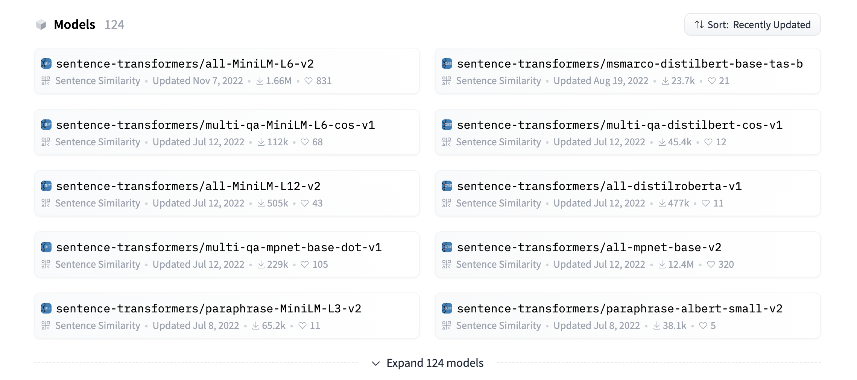
Example 2 – Variables to Tweak – Hugging Face Related
Hugging Face Hub Embeddings
query_text
embedding_model_id
2.0 Search Query
2.1 Embedded Search Query
Watson Assistant
1. Search
2.2 Search Parameters
3. Context for the Search Query
Customer’s Data Sources
6. Answer
Milvus
Watsonx.ai
4. Query + Context
5. Generated Answer
Github link – Example 2: https://github.com/watson-developer-cloud/assistant-toolkit/tree/master/integrations/extensions/starter-kits/language-model-conversational-search

Slide 23
Example 2 – Variables to Tweak – Milvus Related
Hugging Face Hub Embeddings
search_params
2.0 Search Query
2.1 Embedded Search Query
Watson Assistant
1. Search
2.2 Search Parameters
3. Context for the Search Query
Customer’s Data Sources
6. Answer
Milvus
Watsonx.ai
4. Query + Context
5. Generated Answer
Github link – Example 2: https://github.com/watson-developer-cloud/assistant-toolkit/tree/master/integrations/extensions/starter-kits/language-model-conversational-search

Slide 24
Example 2 – Useful Debugging Variable
model_response
Hugging Face Hub Embeddings
passages
snippet
body.results.score
2.0 Search Query
2.1 Embedded Search Query
Watson Assistant
1. Search
2.2 Search Parameters
3. Context for the Search Query
Customer’s Data Sources
6. Answer
Milvus
Watsonx.ai
4. Query + Context
5. Generated Answer
Github link – Example 2: https://github.com/watson-developer-cloud/assistant-toolkit/tree/master/integrations/extensions/starter-kits/language-model-conversational-search

Slide 25
RAG pattern in a notebook with watsonx.ai
Implementation Details
Github Link : https://github.com/nirandiw/kmpg-nz-enablement.git
If you are demoing the platform to a data science team this will be useful.
This only uses an embedding list as knowledge rep

Slide 26
Any Questions?
Enjoy Building Your own Agent Assistant based on the Retrieval-Augmented Generation (RAG) Pattern!

